Slide 1
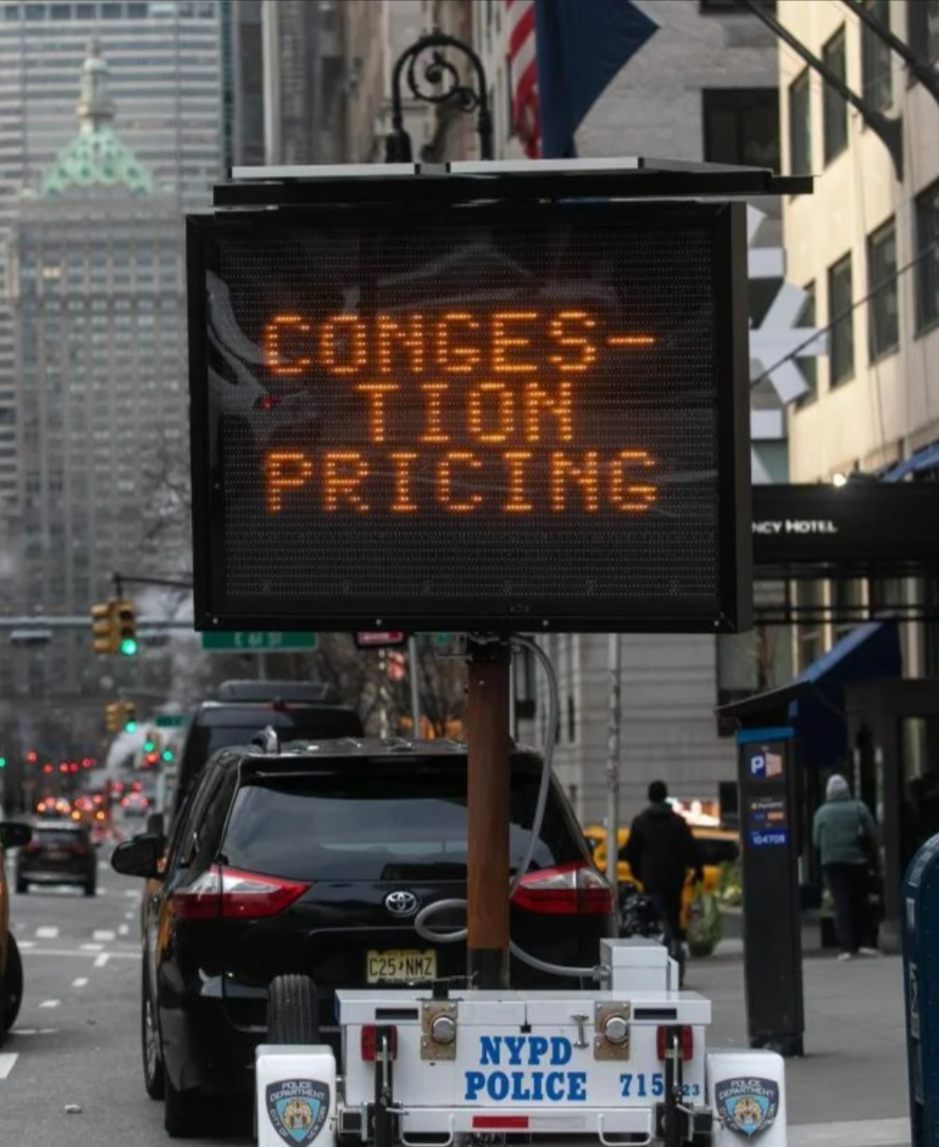
NYU | CUSP
Project Presentation
Evaluating the Impact of Congestion Pricing
On Transit Ridership and
Traffic in NYC’s Five Boroughs
5 May 2025
Members:
Andrew Hwang (yh5975@nyu.edu)
Matt Kohn (mck8331@nyu.edu)
Shu Yang (sy4254@nyu.edu)
Yaqi Guo (yg3481@nyu.edu)
Yuqi Wen (yw8416@nyu.edu)

Slide 2
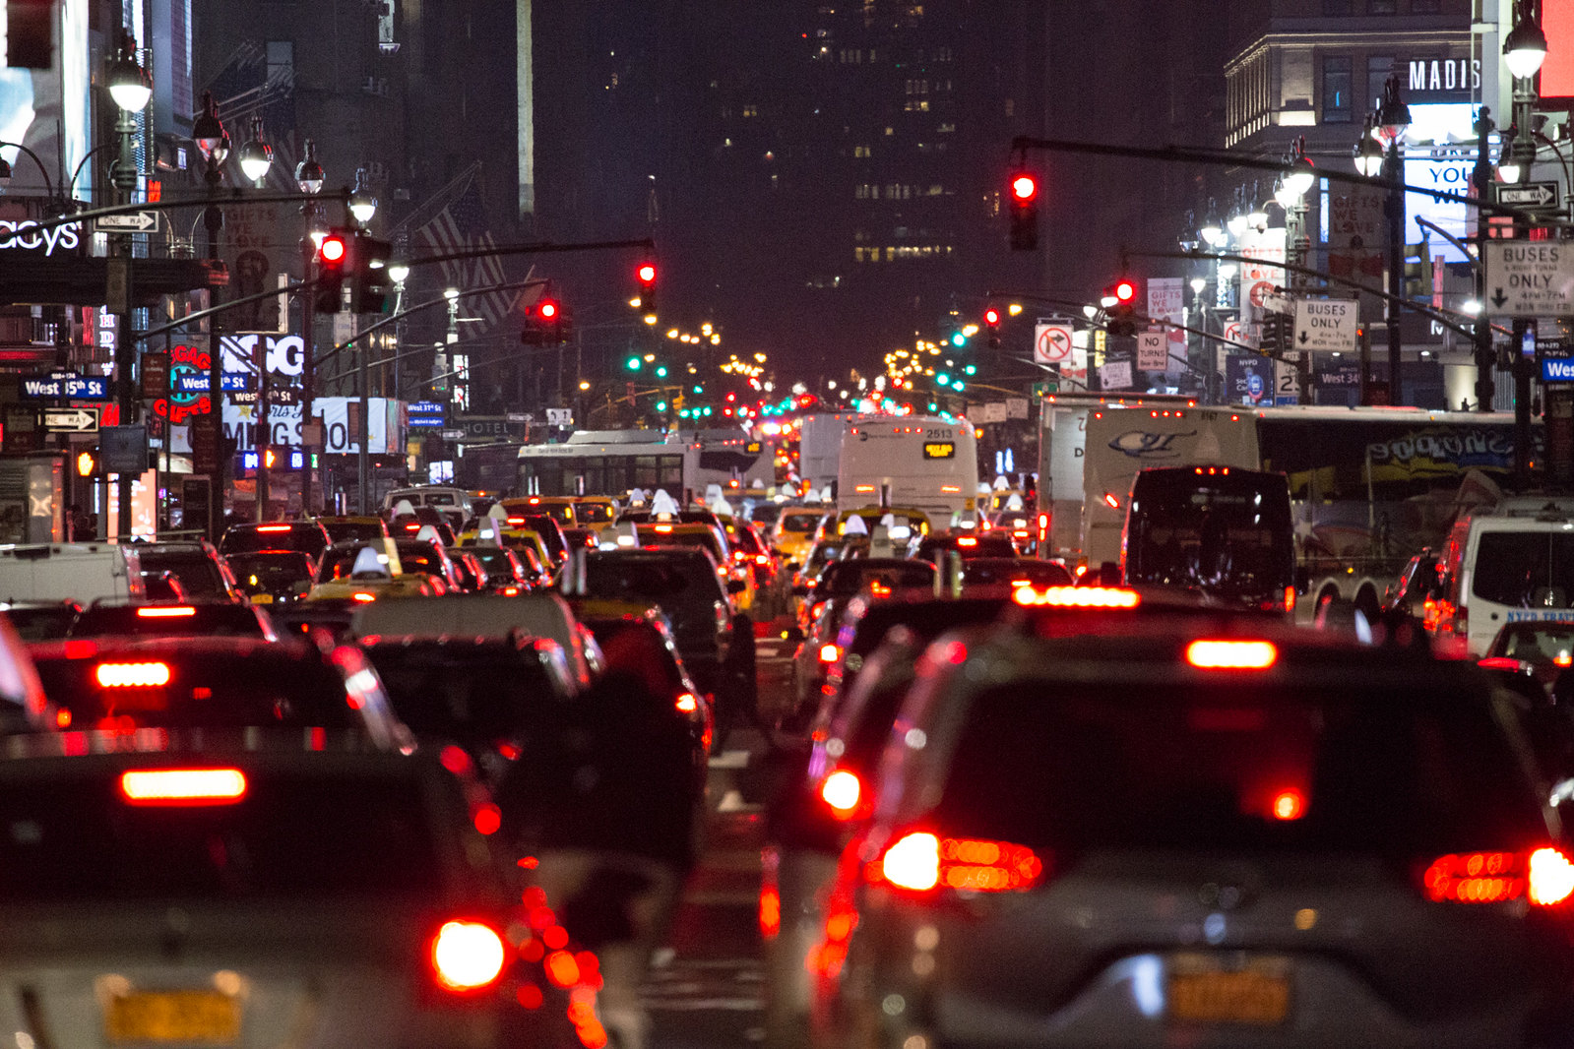
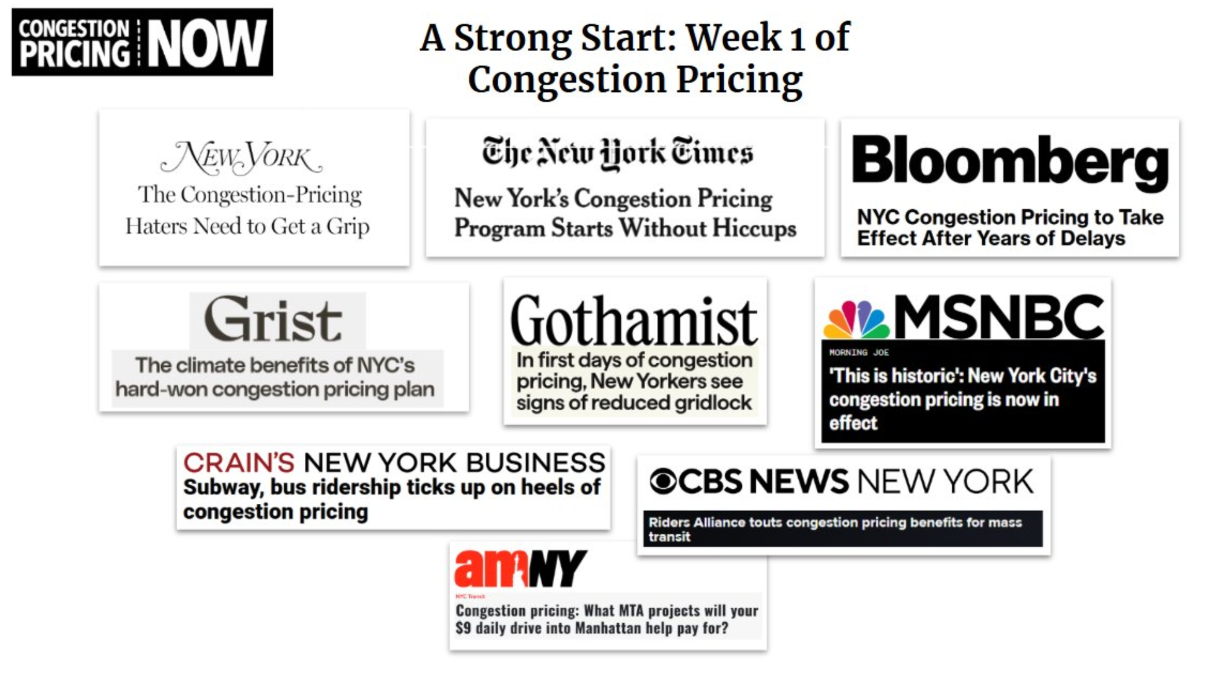
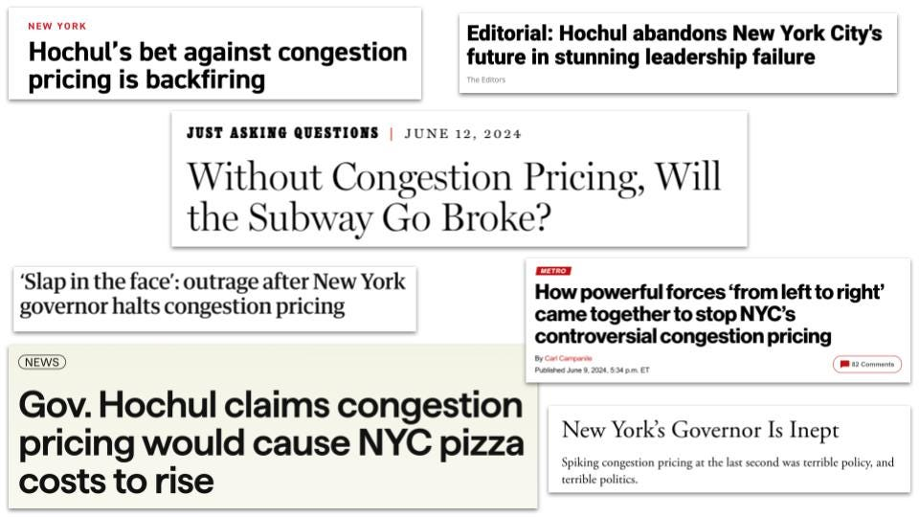
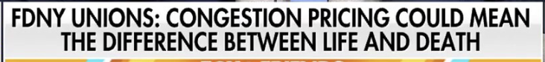
Goal of the Project
NYU | CUSP
NYC is infamous for its traffic congestion, so there is now a congestion pricing program that is very controversial
With much speculation as to whether or not congestion pricing is “working”, we wanted to evaluate its impact on the public transportation system and the city’s traffic volume.

Slide 3
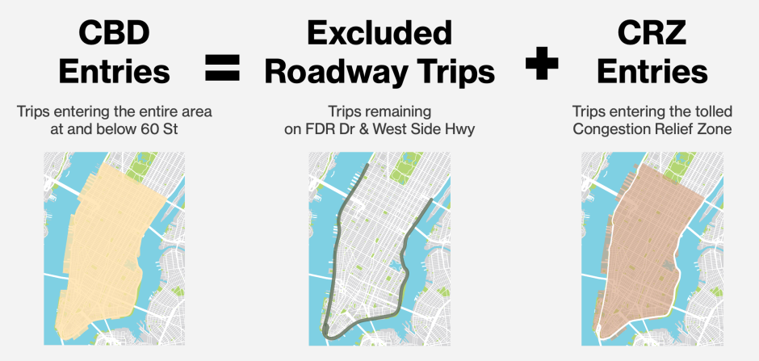
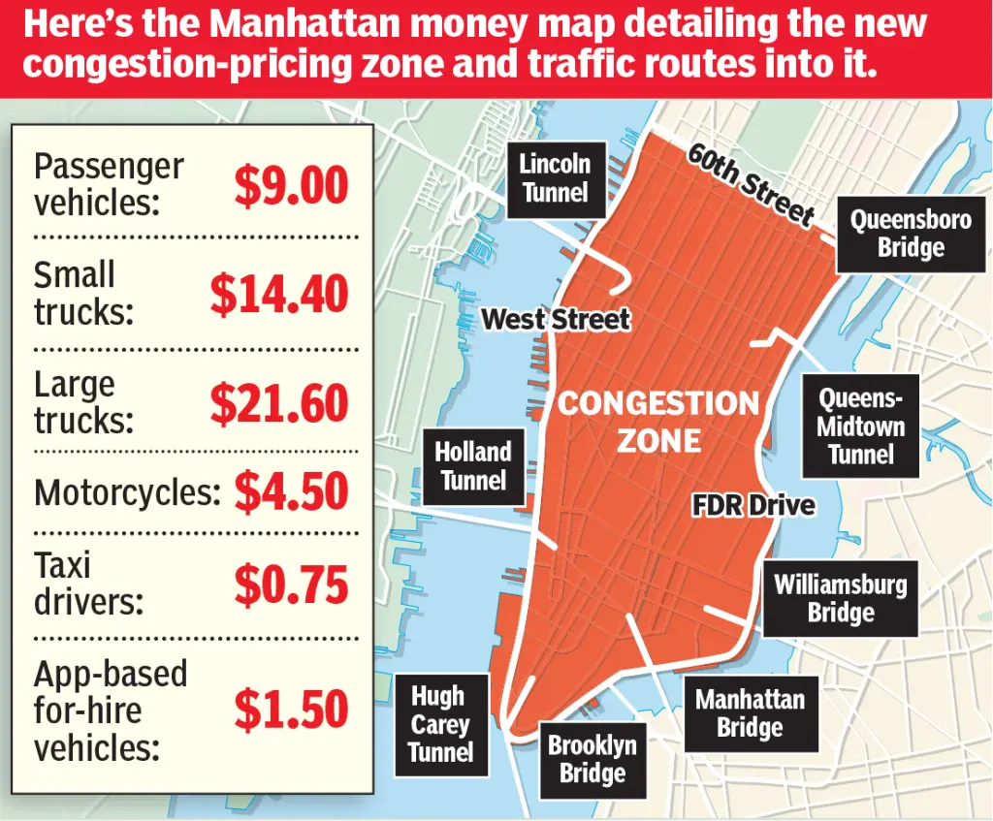
Congestion Pricing Overview
NYU | CUSP
Tolls are depicted below for peak hours, much reduced for off-peak entries
Tolls are in effect most entries in the “Congestion Relief Zone”

Slide 4
Data
NYU | CUSP
We used four datasets to explore and capture the impact of congestion pricing.
Dataset | MTA Subway and Bus Ridership | Traffic Volume | CRZ Vehicle Entries | 311 Complaints
Key Variables | Ridership Counts | Traffic Volume | CRZ Entries | Complaints types, number of incident count
Temporal level | 2023 - Present | 2021-2024.9 | 2025-Present | 2023-Present
Spatial level | By Station | By Sensor | By Entry | By Zip Code
Limitations | Data not available for LIRR, Metro-North, or NJT | Sensor locations are unevenly distributed, temporal coverage is incomplete for many sensors | Data collection began only after policy implementation; lacks pre-policy baseline | 311 dataset is indirect measure to assess the effects. Complaints are subjective, it could be biased.

Slide 5





I think we can draw a diagram describing:
datasets → Models used → analysis
Methods
NYU | CUSP
Traffic Volume
Interpretation:
Behavior Change
Policy Effectiveness
Seasonal Decomposition
Adjust CRZ Data
(Remove Seasonality)
CRZ Vehicle Entries
Time Series
MTA Subway and Bus Ridership
SARIMA Forecasting
Compare Forecast vs. Actual Statistical Tests
Causal
Inference
NYPD Crash and Vehicle Datasets
Chi-Square,
DiD and DiDiD
Compare Pre-Post Crash Patterns by Time & Zone
Spatial Clustering
(Low/Med/High Complaints)
311 Complaints
K-Means Clustering
Rule-Based Grouping
(Jan–Apr 2024→2025)
Cluster

Slide 6
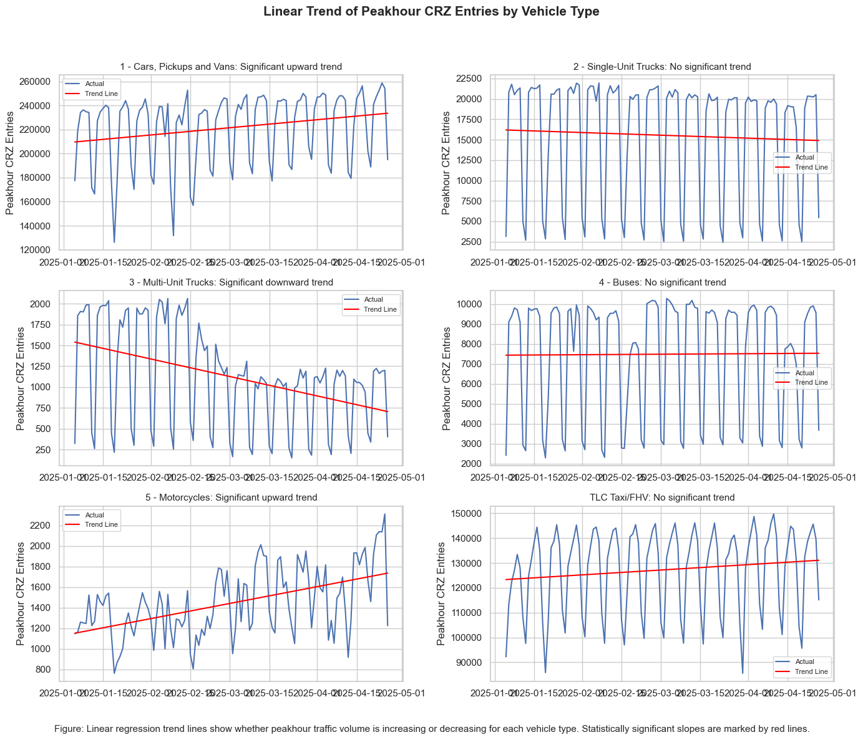
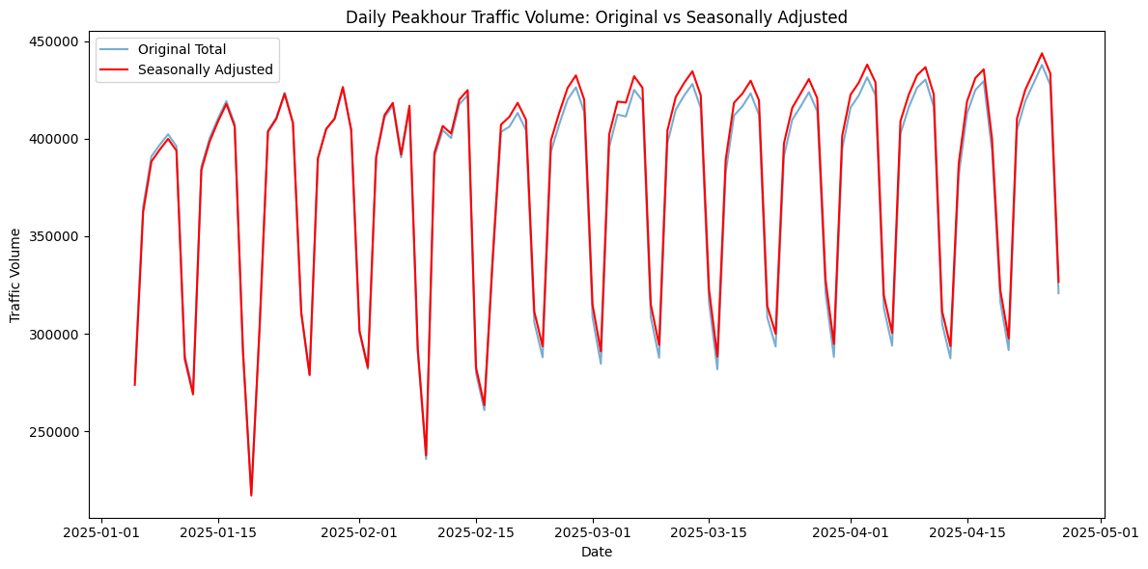
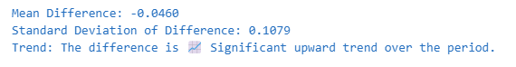
Results: Traffic Volume & CRZ Vehicle Entries
NYU | CUSP
Only multi-unit trucks showed a decline in traffic volume after congestion pricing. Peak-hour CRZ traffic remained largely unchanged, even after adjusting for seasonality.

Slide 7
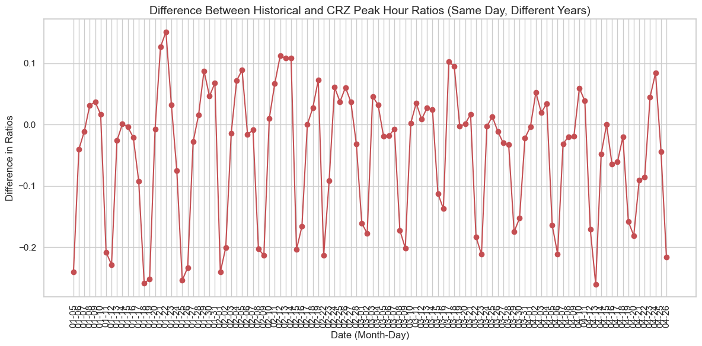
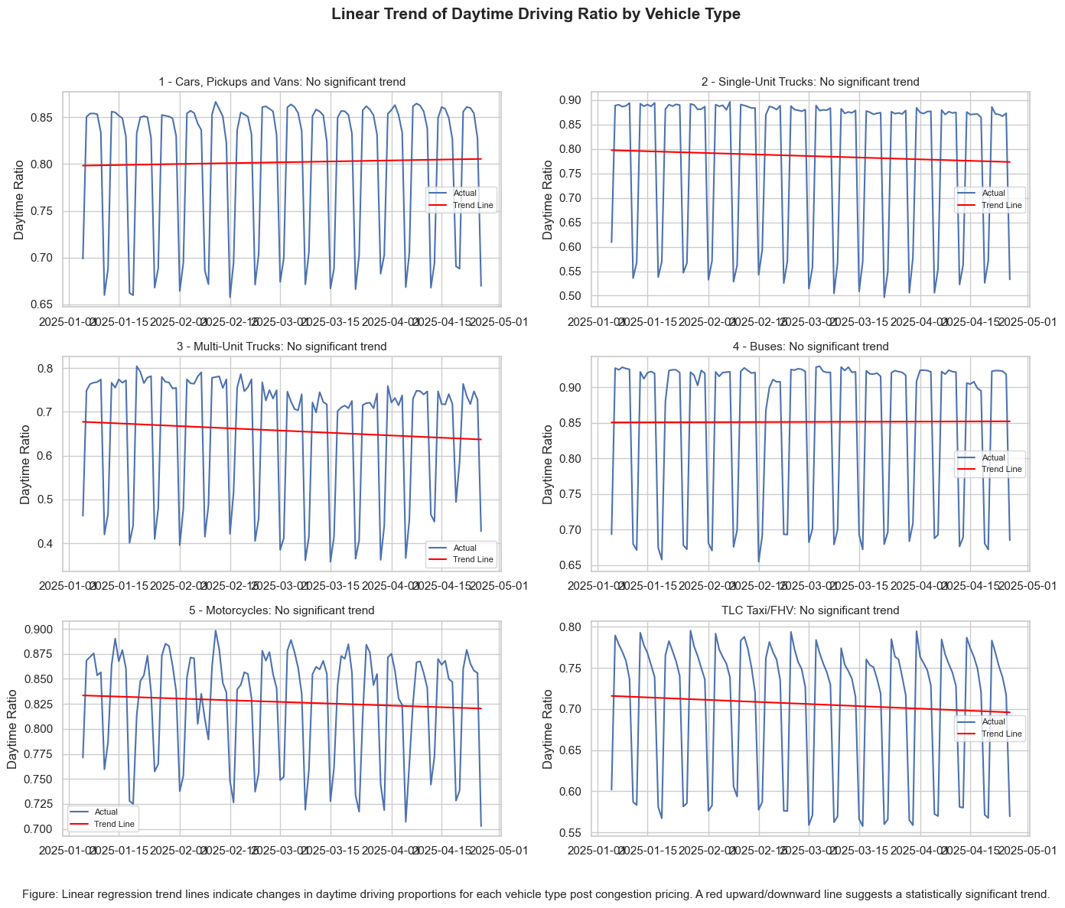
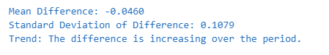
Results: Traffic Volume & CRZ Vehicle Entries
NYU | CUSP
Peak-hour ratio trends remained stable, but compared to historical data, the peak-hour share dropped by 0.046 on average, suggesting a gradual shift toward off-peak travel as people adapt to the policy.

Slide 8
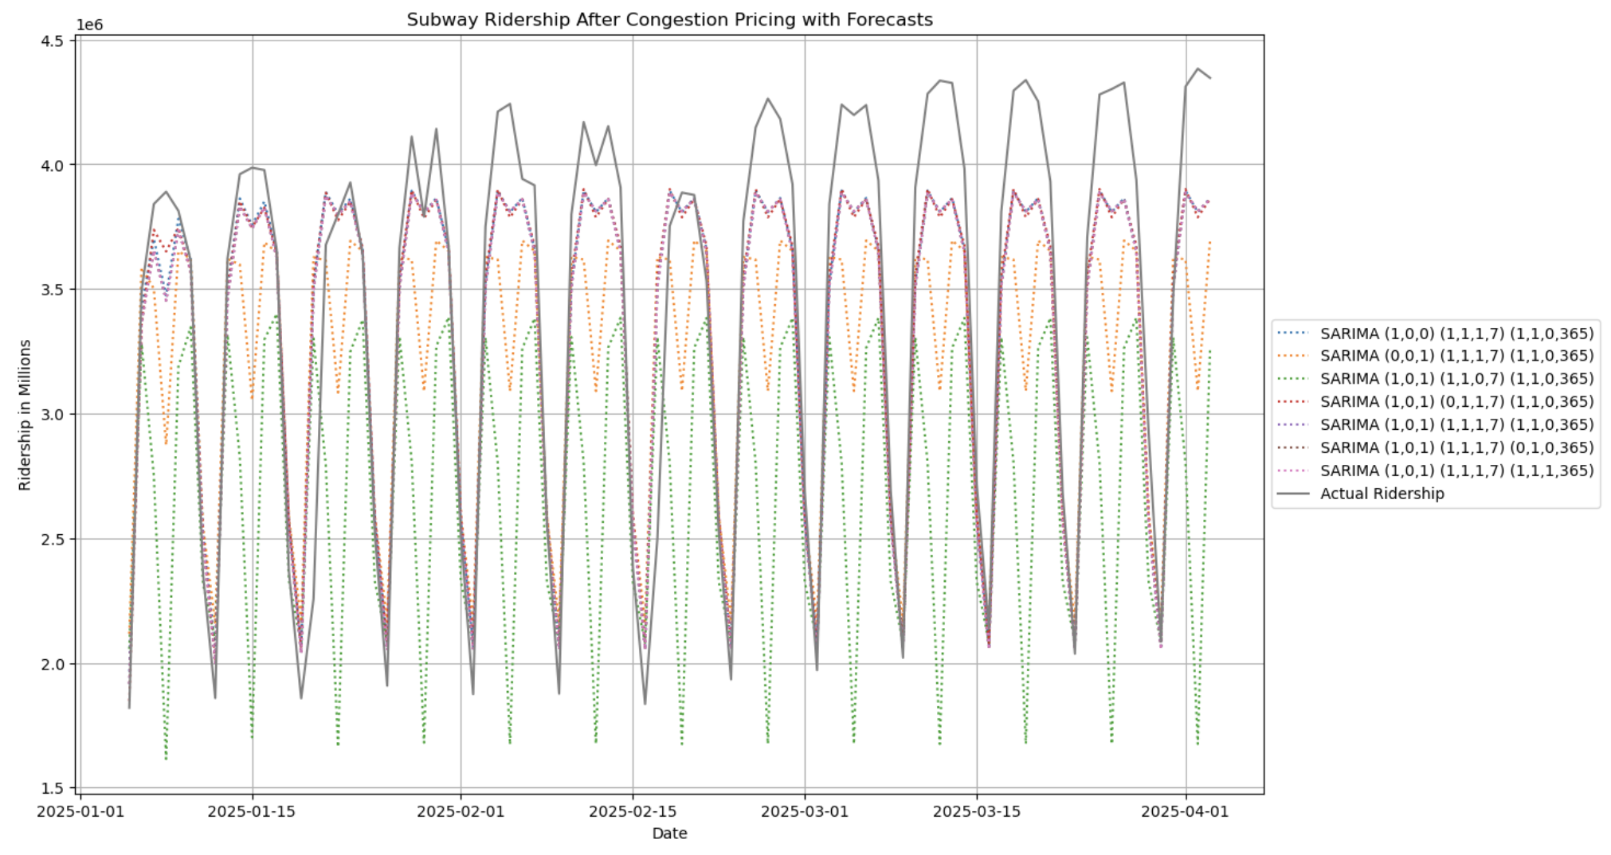
Results: Ridership (Subway)
NYU | CUSP
Used different permutations of parameters for SARIMA to account for different forecasting techniques based on autocorrelation and partial autocorrelation plots
Actual ridership consistently outperforms all forecasts using 2023-2024 ridership training data

Slide 9
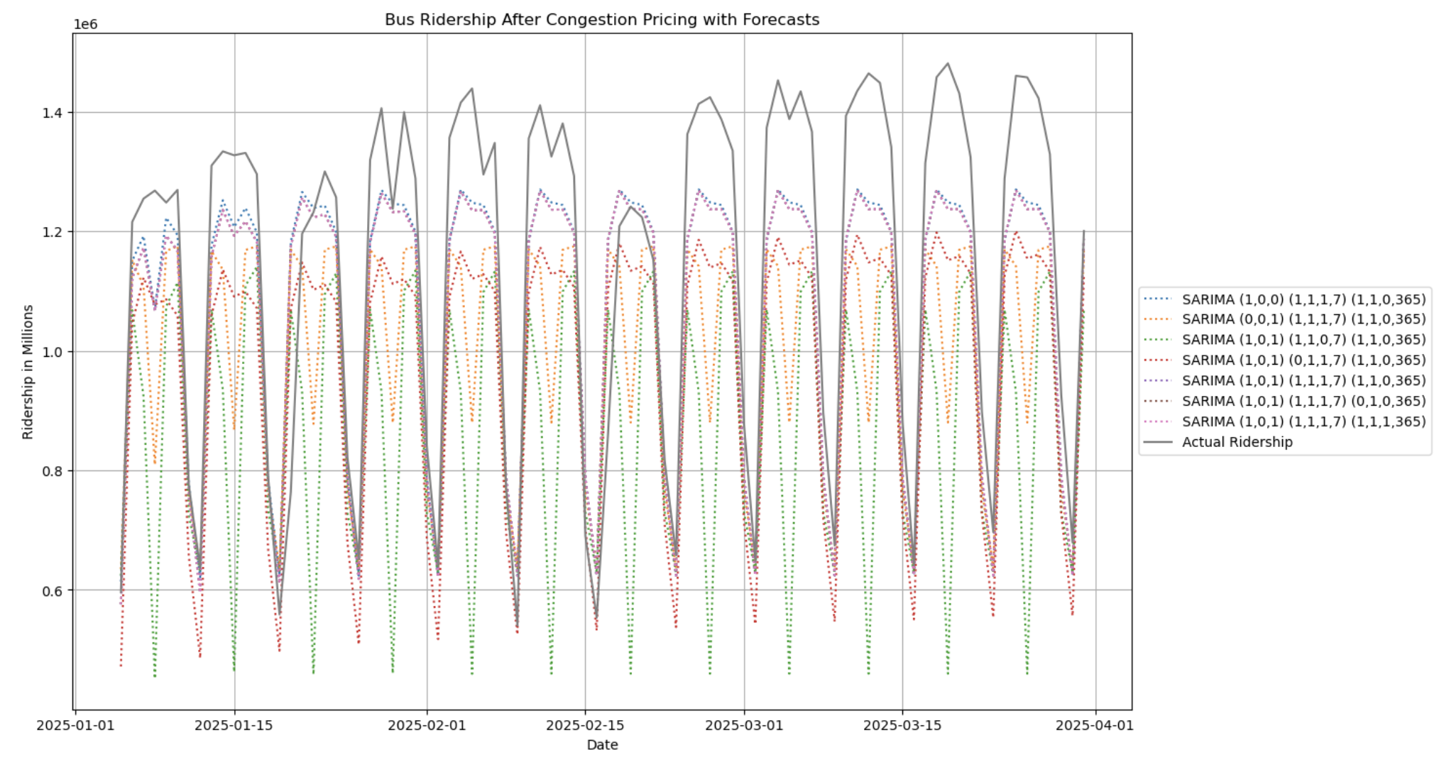
Results: Ridership (Bus)
NYU | CUSP
Actual ridership consistently outperforms all forecasts using 2023-2024 ridership training data
The actual ridership distribution for bus ridership is found to be statistically significantly different from all forecast distributions

Slide 10
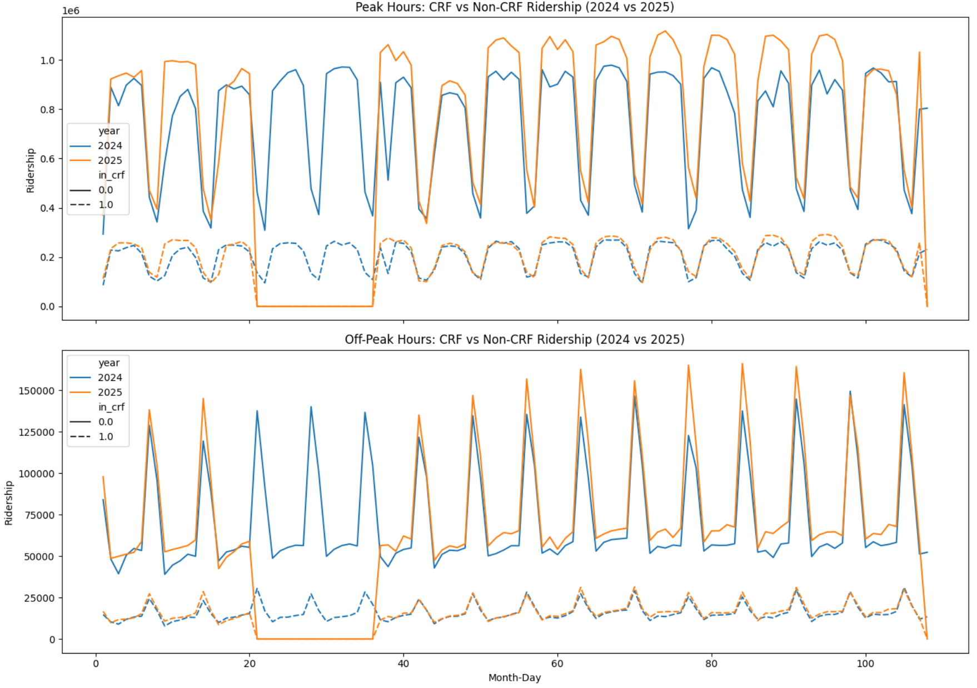
Results: Ridership (Bus)
NYU | CUSP
Non-CRF areas a clear rise in bus ridership in 2025.
CRF areas showed relatively flat ridership levels, with little to no increase after policy implementation.

Slide 11
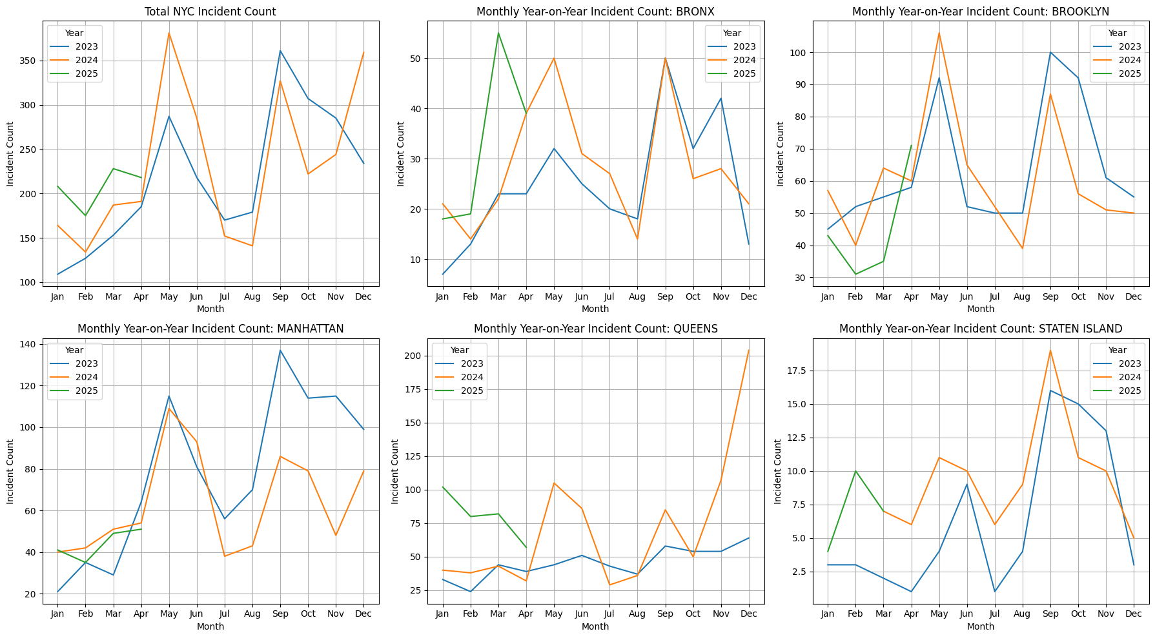
Results: 311 Complaints
NYU | CUSP
We noticed a decrease in Manhattan, and a sharp increase in Bronx

Slide 12
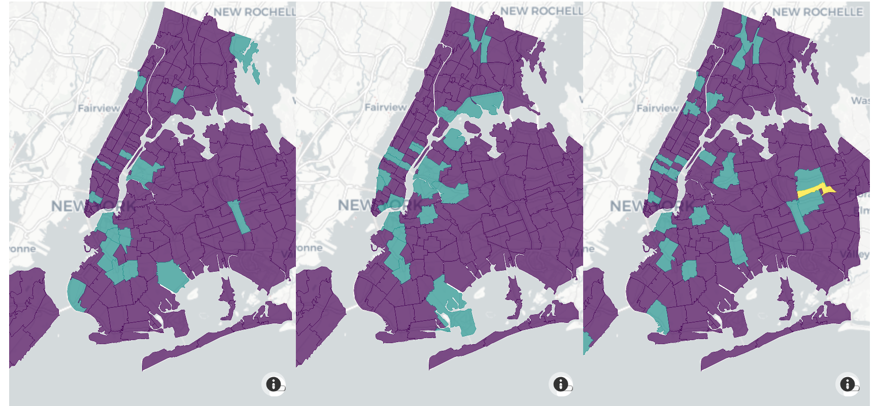
Results: 311 Complaints
NYU | CUSP
K-means Clustering for each year for Jan-Apr
Improvements in Manhattan (CBD), Worsening in Upper Manhattan, South Bronx, Astoria
2023
2024
2025

Slide 13
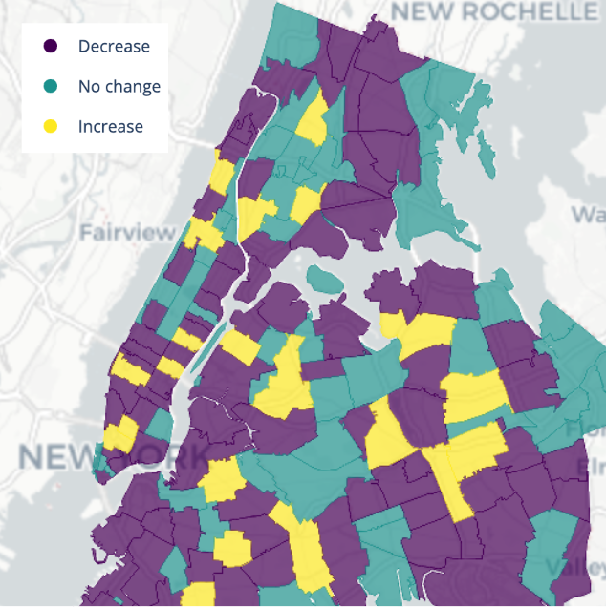
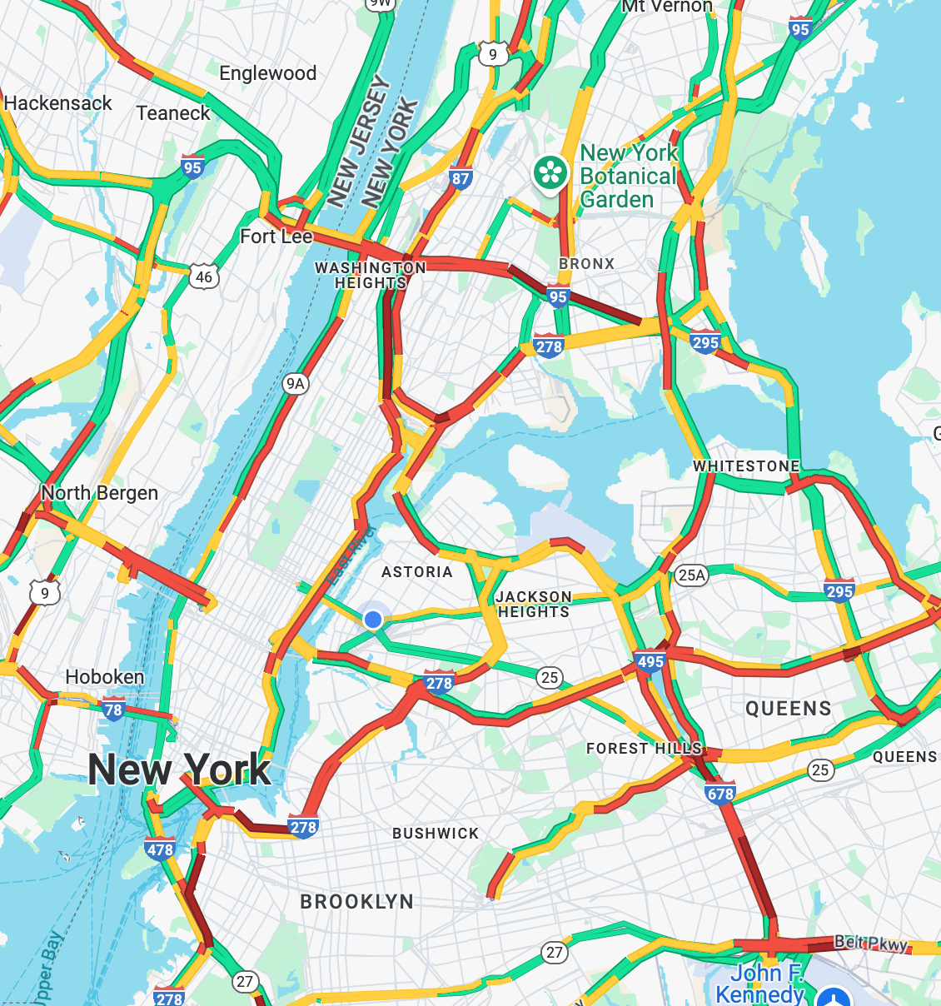
Results: 311 Complaints
NYU | CUSP
Comparing changes in the number of incident counts for 2024 Vs. 2025
Vehicles making detour to avoid Congestion charges
Yellow = Complaints Increased
Google Traffic Flow = Typical Friday Afternoon
Notes:
Conclusion
We believe that vehicles attempting to avoid congestion pricing are taking alternative routes, which has led to congestion issues in these newly affected areas. )

Slide 14
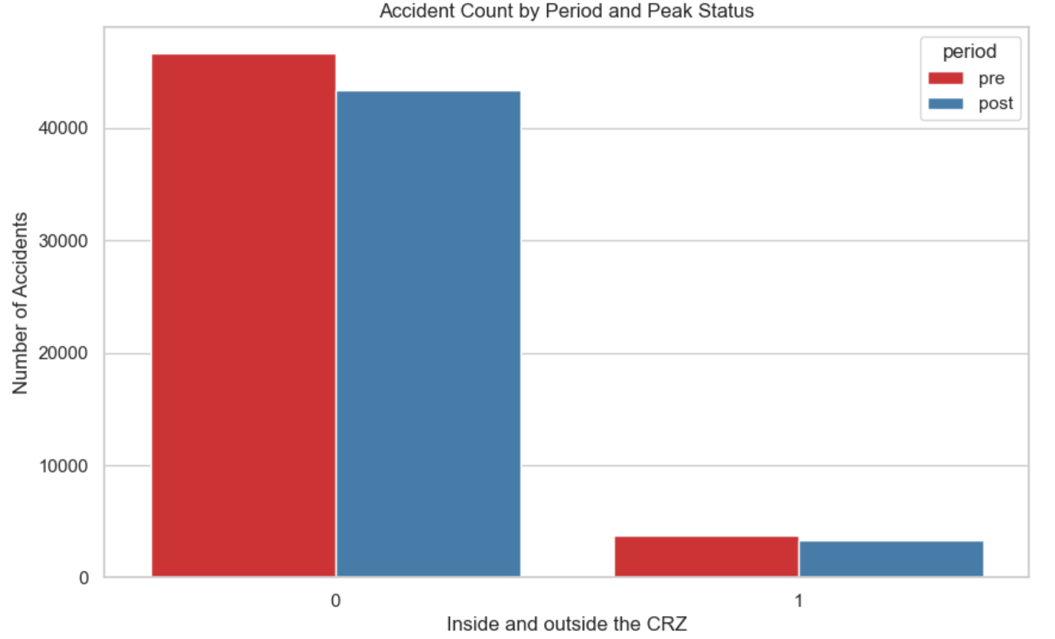
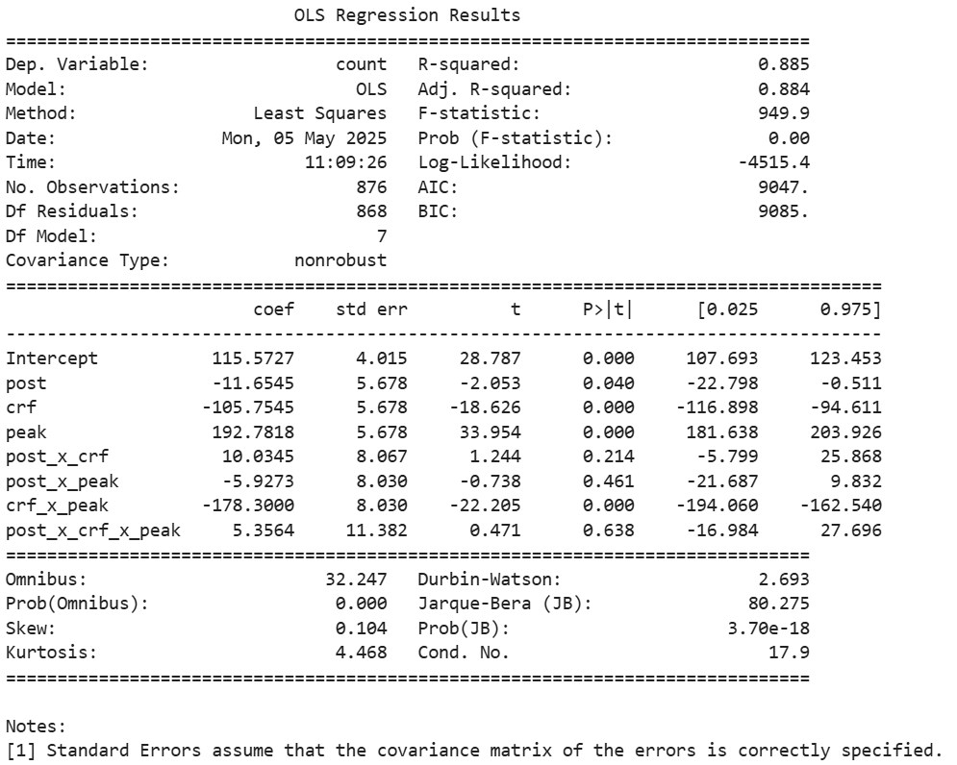
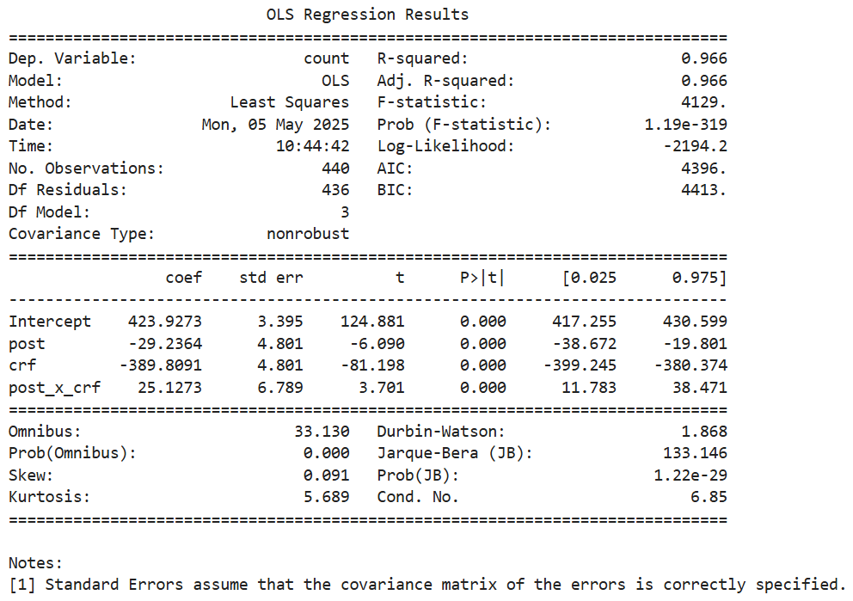
Results: NYPD Crash and Vehicle Datasets
NYU | CUSP
-Overall crashes decreased significantly post-policy (OLS results)
-CRZ-area crashes increased after policy (post × crz > 0, p < 0.001)
-Interpret carefully due to CRZ’s smaller size and high traffic volume
-Likely explanation: rerouting behavior created substitute congestion
-Next steps: standardize crash rates

Slide 15
Conclusion
NYU | CUSP
Direct Impact on Congestion Traffic
Vehicle entries into the CRZ indicate a positive downward trend in traffic volume, particularly during peak hours and on multi-unit trucks.
Direct Impact on Transit Alternatives
Bus and subway ridership consistently exceeded historical forecasts, reflecting a strong mode shift toward public transportation after policy implementation.
Indirect Impact on Surrounding Areas
Residents of neighboring areas have shown signs of a spillover effect, especially Bronx and upper Manhattan.

Slide 16
Limitation
NYU | CUSP
Missing Contextual Features
Lack of further features from other aspects, such as weather, holidays and events, which can be analysed with multimodal Transformer.
Limited Causal Inference
Causal links between congestion pricing and observed traffic changes are unclear due to missing pre-2025 data and post-COVID recovery effects.
Data Sparsity
Sparse traffic volume data as we showed before restricts our ability to conduct a comprehensive analysis over CRZ and other boroughs.

